Slide 1
Stem cells
GODS NATURAL HEALER

Slide 2
STEM CELLS - SC
WHAT ARE SC?
WHAT SC ARE NOT MEANT TO BE
HOW GOD DESIGNED SC

Slide 3
Cells indifferent god designed

Slide 4
PROACTIVE – REACTIVE - REGENERATIVE
Proactive – God designed healing and health, “God said it is good.” Stem Cells grow every day depending on our health.
Reactive – Today’s medicine to be reparative – Jeffrey Epstein’s antiaging, Planned Parenthood selling to highest bidder Science is learning quickly how to imitate God Stem Cells for AIDS, MS, Heart, Diabetics plus more
Regenerative – Advanced medicine and God’s plan applied differently for same result Healing God designed is getting rid of the bad and replacing with the new Science is playing God – who gets the stem cells

Slide 5
Stem Cells
Embryo – first four months of life – undifferentiated cells
Organs such as liver in unborn baby has stem cells to be used for growing other cells
YOU create stem cells daily

Slide 6
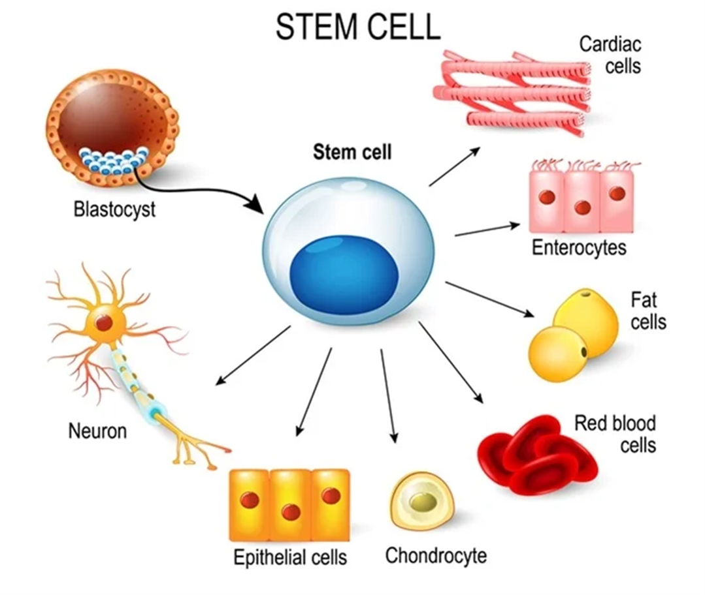
STEM CELLS
ANTI-INFLAMMATORY: HEAL INFLAMMATION
ANTI-AGING: REPLACE OLD CELLS WITH NEW CELLS
ANGIO-GENESIS: NEW BLOOD VESSELS
REGENERATION: EX. NEW HEART CELLS, CONTRACT

Slide 7
SPEED UP DISEASE & SC DEPLETION
STRESS
TOXINS
AGE
POOR DIET
ENVIRONMENTAL TOXINS
MEDICATIONS

Slide 8
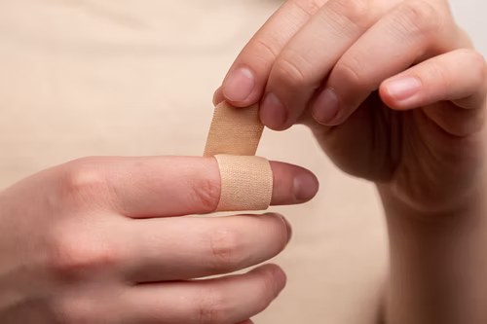
STEM CELLS TO THE RESCUE
Come to injury
Make new cells

Slide 9
FASTING FOR STEM CELLS Speeds up the Renewal
AUTOPHAGY – Death of bad and old cells, using old cells for energy,
Most intensive when fasting
Stimulates replacement cells
STIMULATES – stem cell production
New cells work harder
Fasting makes the cells more dependent on using fat for energy – not sugar

Slide 10
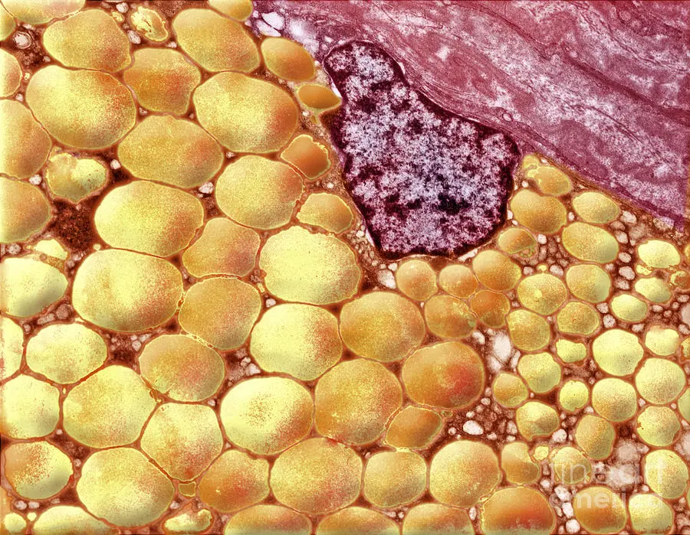
FAT BURNING = TOXINS REMOVED
Releases into the blood stream and body
Feel bad
Ache
Pain
Nausea
Headache Stem Cells Gobble Up Fat Cells

Slide 11
SHORT FASTS: 12-15 HOURS
Starts the autophagy clock Starts the stem cell production

Slide 12
Plan Your Stress-Free Eating/Fasting Discover Habits Contrary to Desired Outcome

Slide 13
Speed Up Healing
Eat Healthful Foods – ALWAYS
Exercise at Healthy Intervals
Praise the Lord - ALWAYS
AVOID Toxins, Rx, Bitterness, Stress
Drink Purified Water
FAST Weekly
FAST Monthly

